Slide 1




LOST & FOUND
SYSTEM
PRESENTATION BY:- NAZISH SHAIKH

Slide 2
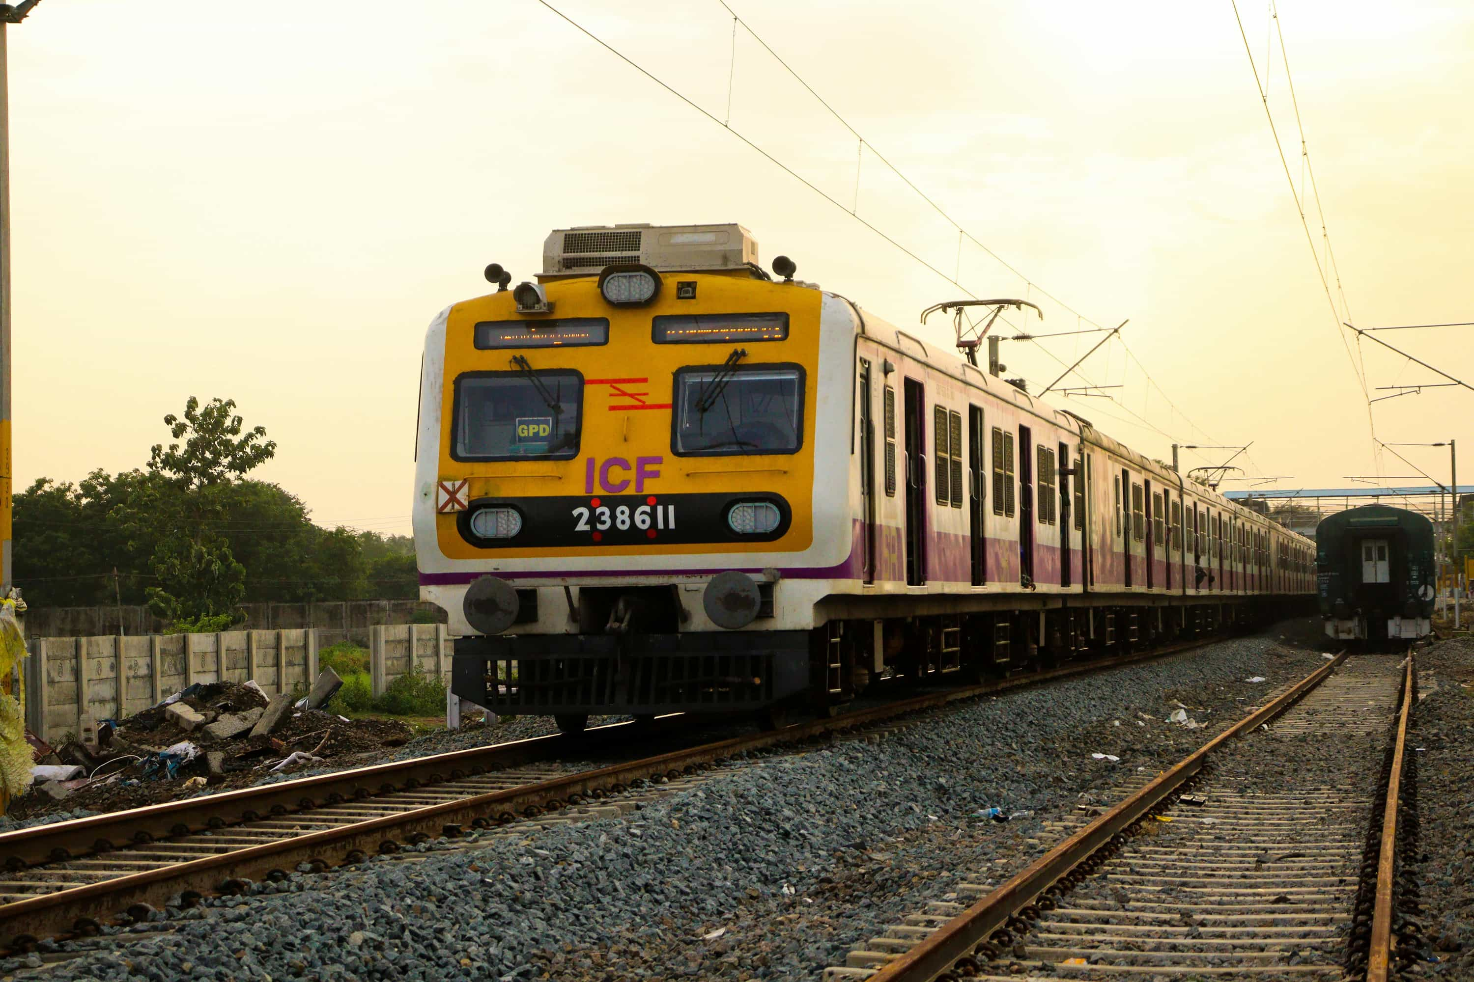
CONTENT
01
02
03
04
05
About Us
The Problem
Our Mission
Why It Matters
Our Idea
06
07
08
09
10
How It Works
Technology Stack
Benefits
Challenges
Thank You

Slide 3
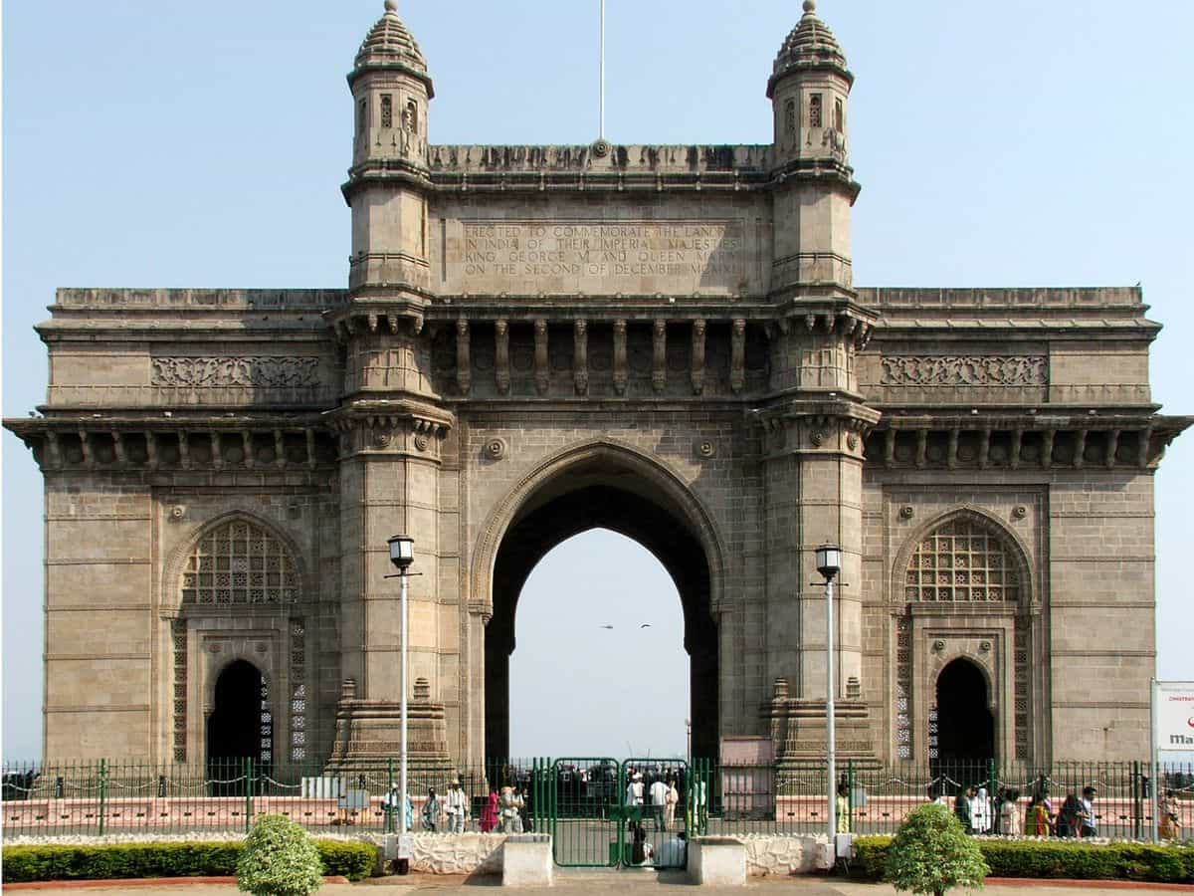


ABOUT US
I am an Student who started this project with the aim of helping daily commuters of Mumbai Local trains. I noticed that people often lose their important belongings such as wallets, bags, and mobile phones, but there was no easy way to report or track them. This inspired me to design a platform that can solve this real problem and make the process simpler for everyone.
Through this project, I want to show how technology can improve daily life. My platform allows users to easily report lost or found items, add details, and track them using just a mobile number. Even though I am working alone on this project, my vision is to create an impactful solution that can truly help the community of millions who depend on Mumbai’s lifeline every day.

Slide 4





THE PROBLEM
Lost Items in Crowded Trains
No Easy Reporting System
Lack of Communication
Low Chances of Recovery
Every day in Mumbai locals, thousands of people lose wallets, mobile phones, and bags because of heavy rush.
Currently, there is no simple online platform where passengers can quickly report or search for lost & found items.
Even if someone finds an item, it is difficult to connect with the real owner due to no proper tracking system.
Most lost items are never returned, leading to stress, financial loss, and inconvenience for passengers.

Slide 5
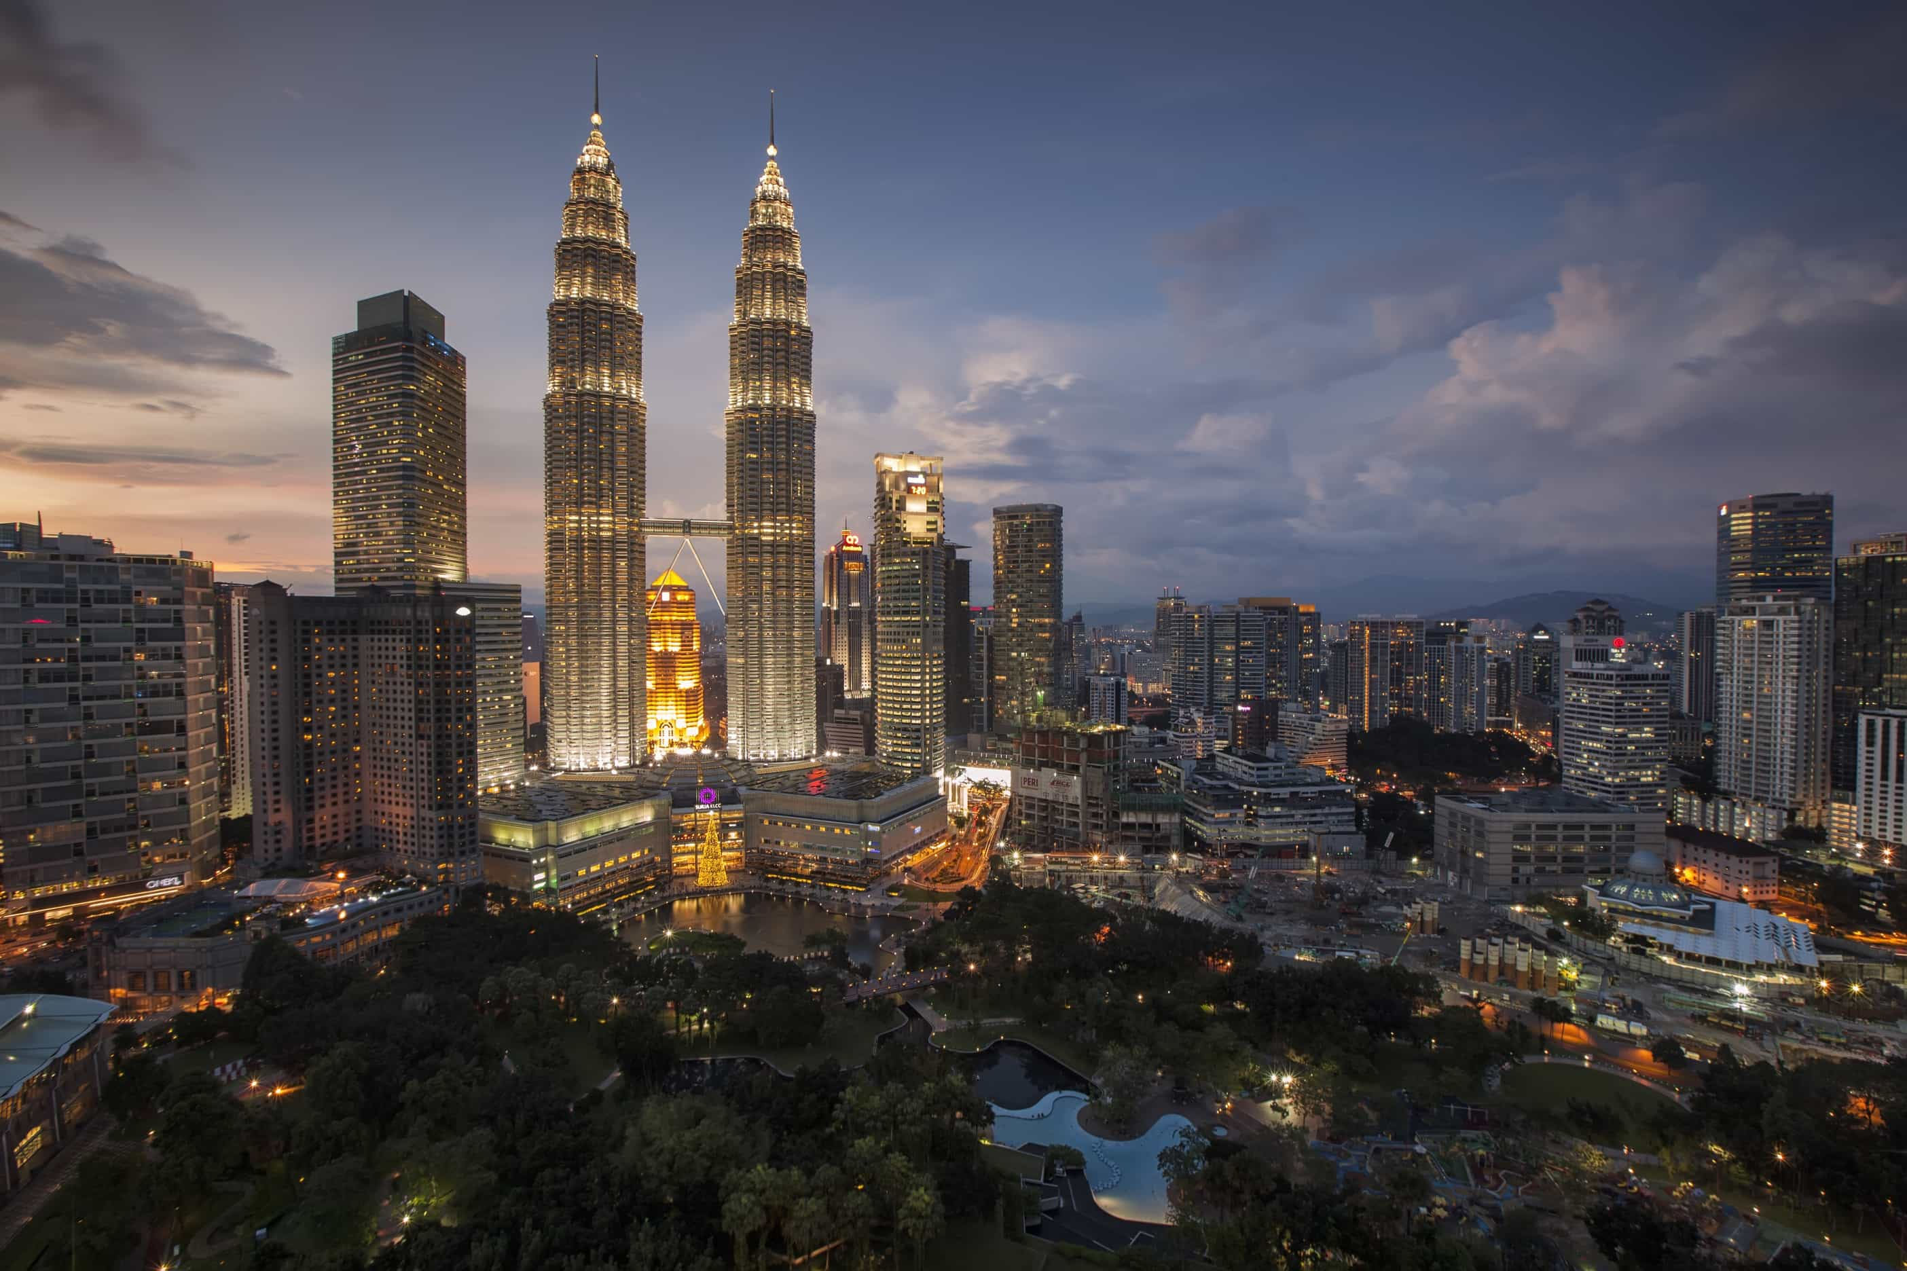



OUR MISSION
Our mission is to make Mumbai local train journeys safer and more reliable by introducing a smart digital system for Lost & Found management. We want to help passengers quickly report lost items and easily track if their belongings have been found.
01
02
We want to connect passengers and helpers so that lost belongings like wallets, phones, or ID cards can be returned quickly.
03
Our goal is to build trust and comfort in public transport, making journeys stress-free and reliable for everyone.

Slide 6
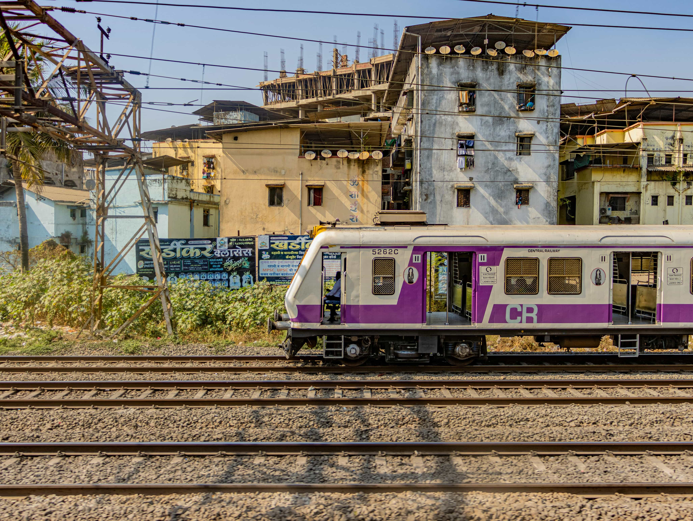



WHY IT MATTERS
Every day, thousands of passengers travel in Mumbai locals, and many lose valuable belongings in the rush. Without a proper system, these items are rarely recovered. Our project matters because it gives people hope and trust that if something is lost, it can be tracked and returned safely, making travel more secure and stress-free.
Presentation and Sharing
Review and Editing
Project Initiation

Slide 7


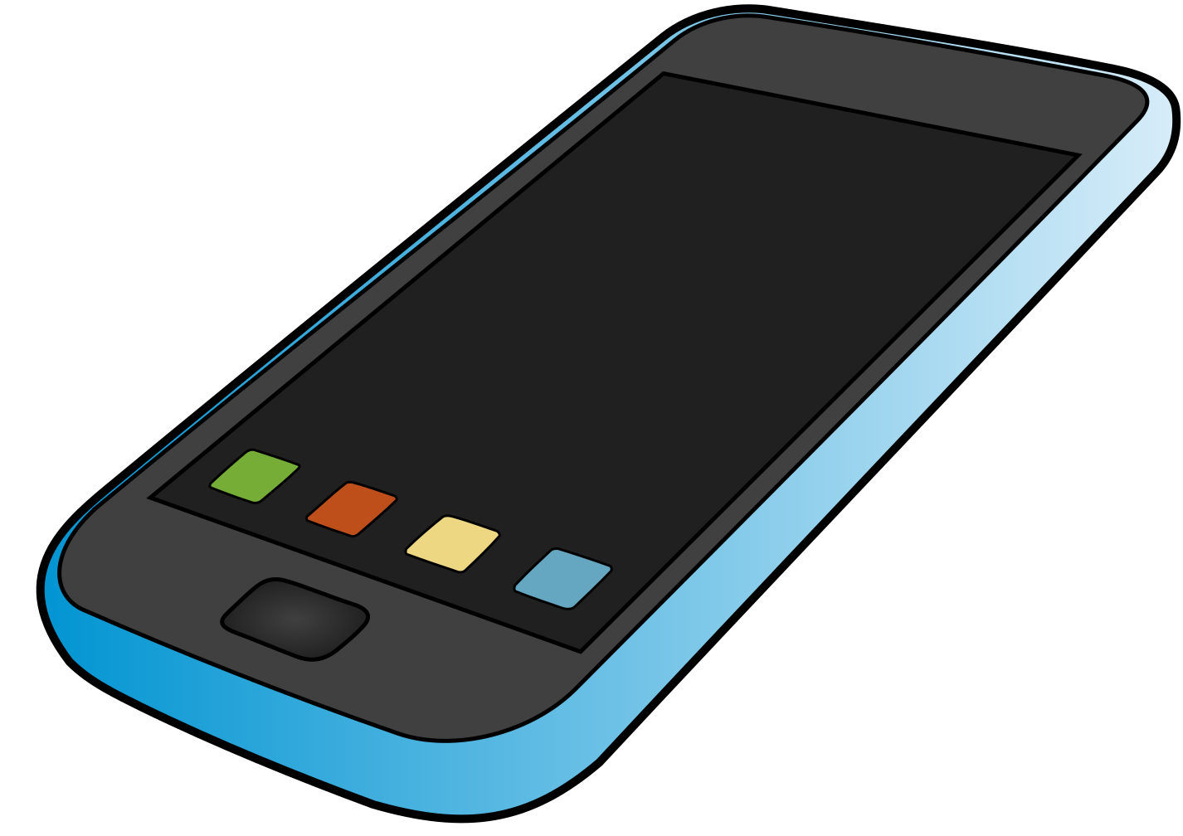
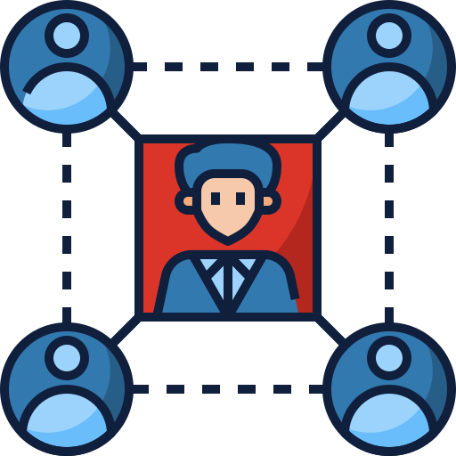


Mobile Number Based Search
Photo Upload Option
User-Friendly Interface
Quick tracking using contact details for instant results.
Users can upload images of lost or found items for better identification.
Simple design for commuters of all age groups to use without difficulty.
Lost & Found Tracking
Centralized Database
Community-Driven Support
A digital system where passengers can report or search lost items easily.
Secure storage of all reports (lost & found) in one place.
Encouraging passengers to help each other by reporting found items.

Slide 8




HOW IT WORKS
Our system starts with a simple reporting process. Anyone who loses or finds an item can quickly fill out a form with details like item name, description, location, date, and contact number. They can also upload an image for better clarity.
Next, all reports are stored in a centralized database. When a user wants to track an item, they just enter their mobile number. The system then searches across both lost and found records to display matching results instantly.
Finally, the platform ensures easy communication between the finder and the owner. With contact details and status updates, the handover becomes smooth, secure, and trustworthy — saving people time and stress.

Slide 9

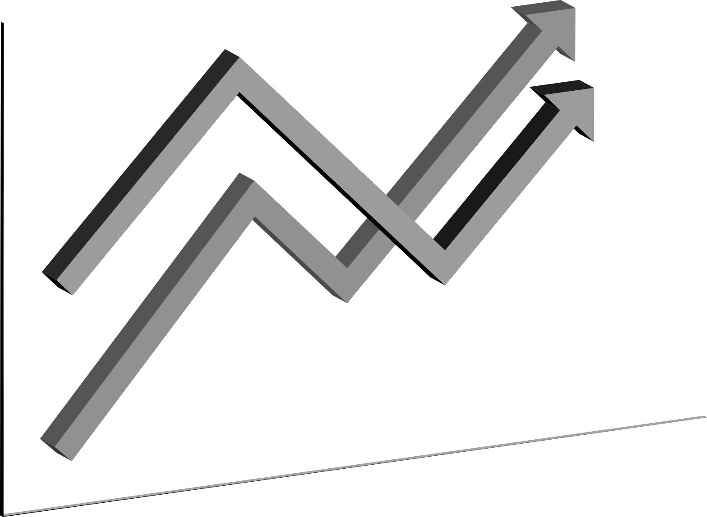
TECHNOLOGY STACK
BACKEND
FRONTEND
React.js – Used to build the user interface (pages, forms, tracking system)
CSS (Custom Styles) – For styling and making the design responsive
FastAPI (Python) – To create the server and API endpoints
Uvicorn – To run the FastAPI server
TOOLS & ENVIRONMENT
STORAGE
LocalStorage (Browser) – Currently used to save and track lost & found reports
Node.js & npm – For running the React app and managing packages
Virtual Environment (venv) – To keep Python dependencies isolated

Slide 10
BENEFITS
Quick Access
Simple & User Friendly
Secure Data Handling
Users can easily track their lost or found items by just entering their mobile number. This makes the process faster compared to traditional manual reporting.
The platform is designed with a clean interface and easy navigation. Even first-time users can report or track items without any technical knowledge.
All reports are stored safely using local storage for now, ensuring privacy. In future, the system can be upgraded to cloud for better scalability and security.

Slide 11

CHALLENGES
Working Alone – Managing the entire project (frontend + backend) without any team support.
Time Management – Balancing coding, design, and testing in limited time.
Technical Errors – Debugging issues in React, FastAPI, and database connectivity alone.
Integration Issues – Connecting frontend (React) with backend (FastAPI) smoothly.
Testing on Real Use Cases – Making sure booking, tracking, and reports work like real-world Mumbai locals.
User-Friendly Design – Making sure the app is simple and easy for normal passengers to use.
Learning Curve – Exploring new tools and libraries while implementing the project.
Data Handling – Managing local storage and ensuring correct tracking of lost & found items.

Slide 12





THANK'S FOR WATCHING

